Slide 1
Session 8
Introduction to Databases and SQL
JDBC

Slide 2
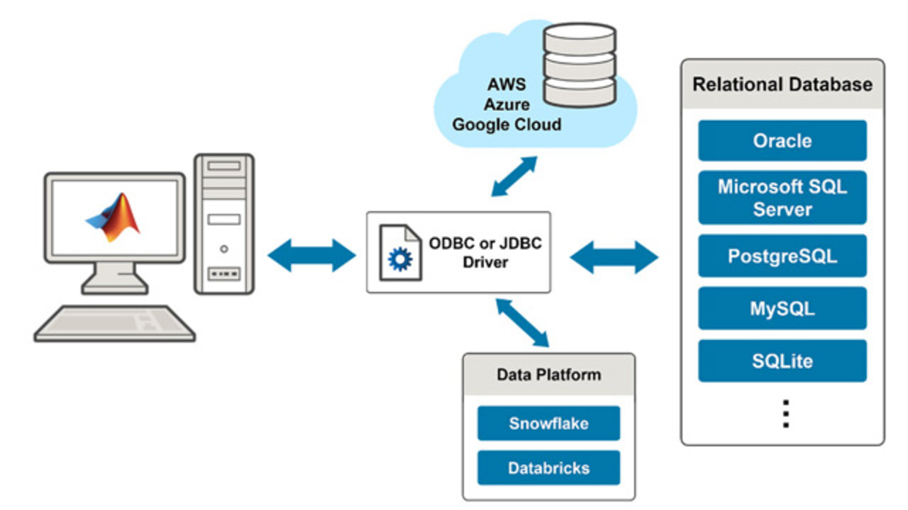
What is a Database?
Definition and importance of databases in software development.
Types of databases: relational, NoSQL

Slide 3
Introduction to SQL
Definition and role of SQL (Structured Query Language) in databases.
SQL as a standard language for querying and manipulating databases.
Setup
Mysql server(530 MB) https://dev.mysql.com/downloads/mysql/
or use SQLLite
  (1.5MB) https://www.sqlitetutorial.net/download-install-sqlite/
  (38 MB UI tool for DB) https://github.com/pawelsalawa/sqlitestudio/releases
  Go to folder of sqllite in DOS CMD and type sqlite3 student.db
Type .databases to list available databases
In sqllite studio click Database>> add new database
Select the file student.db (this will be created in sqllite folder)
Follow steps as per https://www.sqlitetutorial.net/download-install-sqlite/

Slide 4
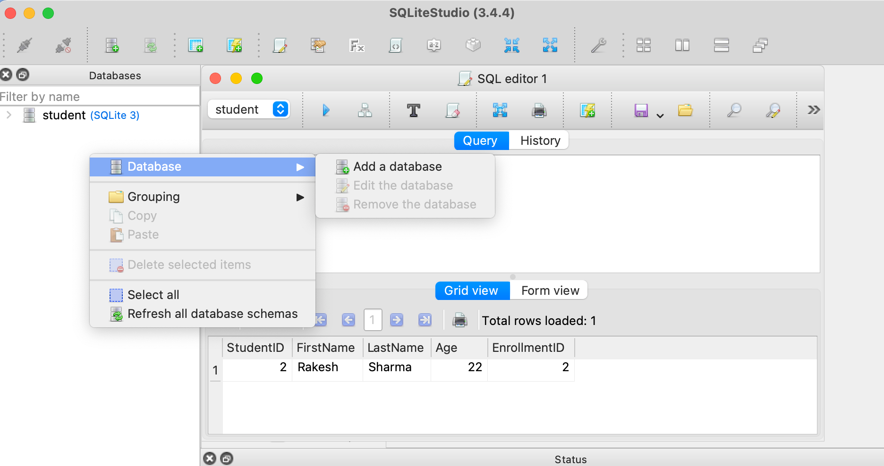

Slide 5
Basic SQL Commands
SELECT, INSERT, UPDATE, DELETE statements.
Retrieving data using SELECT with WHERE, ORDER BY, and LIMIT.
Inserting, updating, and deleting data using corresponding commands.

Slide 6
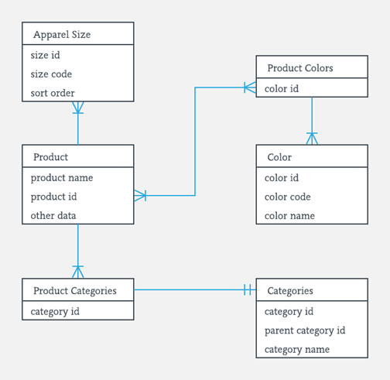
Database Design Concepts
Understanding tables, rows, columns, and relationships.
Primary keys, foreign keys, and constraints.
Normalization and denormalization concepts.

Slide 7
Java Database Connectivity (JDBC)
Introduction to JDBC and its role in connecting Java with databases.
Steps to establish a connection using JDBC.

Slide 8
Setting Up a JDBC Connection
Loading JDBC drivers.
Establishing database connections using DriverManager.
Handling connection exceptions.

Slide 9
Executing SQL Statements
Creating Statement and PreparedStatement objects.
Executing SQL queries and updates.
Handling ResultSet to retrieve data.

Slide 10
MySQL Overview
Introduction to MySQL as a popular open-source relational database management system.
Features and benefits of using MySQL.

Slide 11
Setting Up MySQL
Installing MySQL server.
Creating a database and user.

Slide 12
Basic MySQL Commands
Creating tables with data types and constraints.
Retrieving and manipulating data using SQL commands.

Slide 13
JDBC Connection to MySQL
Establishing a JDBC connection to a MySQL database.
Using connection properties and configuration.

Slide 14
CRUD Operations with Java and MySQL
Performing CREATE, READ, UPDATE, DELETE operations using Java and MySQL.
Writing Java code to interact with the database.

Slide 15
Handling Transactions
Understanding transactions and their importance.
Using the `commit` and `rollback` methods.
Implementing error handling and data integrity.

Slide 16
Indexes and Optimization
Introduction to indexes and their impact on query performance.
Creating indexes on columns.
Query optimization techniques.

Slide 17
Stored Procedures and Functions
Writing and executing stored procedures in MySQL.
Creating and using user-defined functions.

Slide 18
Handling Relationships
Understanding different types of relationships: one-to-one, one-to-many, many-to-many.
Implementing relationships using foreign keys.

Slide 19
Data Security and Authentication
Introduction to data security and authentication concepts.
Using user accounts, privileges, and roles.

Slide 20
Examples - SQL (DDL - Data definition language)
1. Creating a Table:
CREATE TABLE Students (
StudentID INT PRIMARY KEY,
FirstName VARCHAR(50),
LastName VARCHAR(50),
Age INT,
CourseID INT
);

Slide 21
SQL queries (DML - Data manipulation language)
1. Inserting Data:
INSERT INTO Students (StudentID, FirstName, LastName, Age)
VALUES (1, 'Ram', 'Krishna', 20),
(2, 'Rakesh', 'Sharma', 22),
(3, 'Sita', 'Raghav', 21);
2. Selecting Data:
SELECT FirstName, LastName FROM Students
WHERE Age > 20;
3. Updating Data:
UPDATE Students
SET Age = 23 WHERE StudentID = 1;
4. Deleting Data:
DELETE FROM Students WHERE StudentID = 3;

Slide 22
Creating Relationships:
CREATE TABLE Courses (
CourseID INT PRIMARY KEY,
CourseName VARCHAR(100)
);

Slide 23
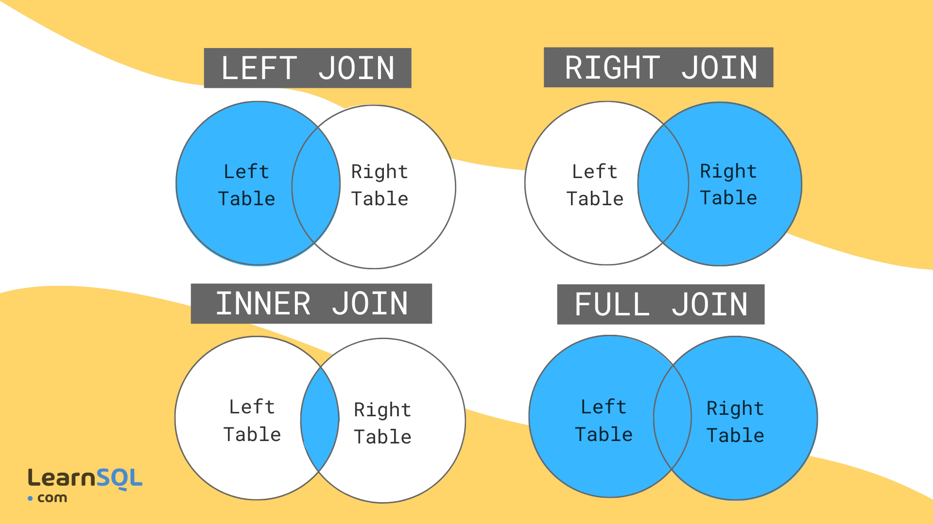
Join
1. Inner Join
An inner join returns only the matching rows from both tables, excluding non-matching rows.
2. Left Join (or Left Outer Join)
A left join returns all rows from the left table and the matching rows from the right table. If there's no match, NULL values are included.
3. Right Join (or Right Outer Join)
A right join is similar to a left join but returns all rows from the right table and the matching rows from the left table.
4. Full Outer Join (or Full Join)
A full outer join returns all rows from both tables, along with matching and non-matching rows. If there's no match, NULL values are included.

Slide 24
Inner Join:
SELECT Students.FirstName, Courses.CourseName
FROM Students
JOIN Courses ON Students.CourseID = Courses.CourseID;

Slide 25
Group By:
SELECT Age, COUNT(*) AS TotalStudents
FROM Students
GROUP BY Age;

Slide 26
Subquery:
SELECT FirstName, LastName
FROM Students
WHERE Age IN (SELECT Age FROM Students WHERE LastName = 'Smith');

Slide 27
Order By:
SELECT FirstName, LastName
FROM Students
ORDER BY LastName ASC, FirstName DESC;

Slide 28
JDBC
package com.bri8.jdbc;
import java.sql.Connection;
import java.sql.DriverManager;
import java.sql.ResultSet;
import java.sql.SQLException;
import java.sql.Statement;
public class JDBCExample {
Connection conn = null;
static String url = "jdbc:sqlite:/Users/sandeepmaloth/projects/java-training/html-js-web-training/sqlite-server/student.db";
public Connection connect() {
try {
this.conn = DriverManager.getConnection(url);// create a connection to the database
System.out.println("Connection to SQLite has been established.");
} catch (SQLException e) {
System.out.println(e.getMessage());
}
return conn;
}
public void close() {
try {
if (conn != null) {
conn.close();
System.out.println("Closed connection");
}
} catch (SQLException ex) {
System.out.println(ex.getMessage());
}
}
public void createTable() {
String sql = "CREATE TABLE IF NOT EXISTS warehouses ("
+ " id integer PRIMARY KEY,"
+ " name text NOT NULL,"
+ " capacity real"
+ ");";
try {
Statement stmt = conn.createStatement();
stmt.execute(sql);
System.out.println("Created table");
} catch (SQLException e) {
System.out.println(e.getMessage());
}
}
public void selectAll() throws SQLException {
String sql = "SELECT * from Students";
Statement stmt = conn.createStatement();
ResultSet rs = stmt.executeQuery(sql);
// loop through the result set
while (rs.next()) {
System.out.println(rs.getInt("StudentID") + "\t" +
rs.getString("FirstName") + "\t" +
rs.getString("LastName"));
}
}
public static void main(String[] args) throws SQLException {
JDBCExample jdbcExample = new JDBCExample();
jdbcExample.connect();
jdbcExample.createTable();
jdbcExample.selectAll();
jdbcExample.close();
}
}

Slide 29
References
https://www.sqlitetutorial.net/sqlite-java/sqlite-jdbc-driver/

Slide 30
Keynotes

